Slide 1
Dynamic programming: Rod cutting
Session 15
Henry Lucky, S.Kom. M.Kom.

Slide 2
Outline Materials
Session 04
Concept of Dynamic programming
Rod cutting problem
Solving rod cutting problem

Slide 3
Learning outcomes
LO 1: Explain fundamental concept of analysis algorithms
LO 2: Apply algorithm techniques and methods
LO 3: Solve a problem using specific algorithm.
LO 4: Compare several algorithm design methods

Slide 4
Concept of dynamic programming
DP vs. divide and conquer
Both solve problems by combining the solutions to subproblems.
Divide-and-conquer algorithms:
Partition a problem into independent subproblems, solve the subproblem recursively, and then combine the solution to solve the original problem.
Inefficient if they solve the same subproblems more than once.
Dynamic programming:
Applicable when the subproblems are not independent (overlapping subproblems)
Solves each subproblem just once and save the answer in a table.

Slide 5
Concept of dynamic programming
The concept
Dynamic programming is typically applied to optimization problems.
In such problem there can be many solutions.
Each solution has a value, and we wish to find a solution with the optimal value.

Slide 6
Concept of dynamic programming
To develop a dynamic-programming algorithm, follow a sequence of four steps:
Characterize the structure of an optimal solution.
Recursively define the value of an optimal solution.
Compute the value of an optimal solution, typically in a bottom-up fashion.
Construct an optimal solution from computed information.

Slide 7

Rod cutting problem
The rod-cutting problem is the following.
Given a rod of length n inches and a table of prices pi for i=1,2,…,n determine the maximum revenue rn obtainable by cutting up the rod and selling the pieces.
Note that if the price pi for a rod of length n is large enough, an optimal solution may require no cutting at all.
If the optimal solution cuts the rod k pieces, for some $1≤k≤n$, then:
n = i1 + i2 + …+ ik
Would provide maximum corresponding revenue:
rn = pi1 + pi2 +… + pik

Slide 8
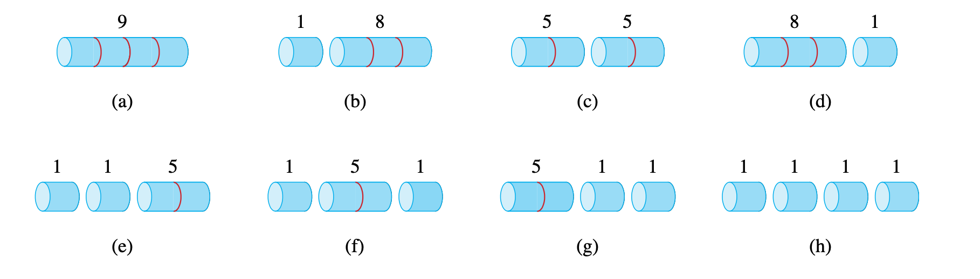
Rod cutting problem
length i | 1 2 3 4 5 6 7 8 9 10
price | 1 5 8 9 10 17 17 20 24 30
The possible ways of cutting up a rod of length 4. Above each piece is the value of that piece, according to the sample price chart of Figure above

Slide 9
Rod cutting problem
r1 = 1 from solution 1 = 1 (no cuts) ,
r2= 5 from solution 2 = 2 (no cuts) ,
r3 = 8 from solution 3 = 3 (no cuts) ,
r4 = 10 from solution 4 = 2 + 2 ,
r5 = 13 from solution 5 = 2 + 3 ,
r6 = 17 from solution 6 = 6 (no cuts) ,
r7 = 18 from solution 7=1+6 or 7=2+2+3 ,
r8 = 22 from solution 8 = 2 + 6 ,
r9 = 25 from solution 9 = 3 + 6 ,
r10 = 30 from solution 10 = 10 (no cuts) ,

Slide 10
More generally , we can frame the values for n 1 in terms of optimal revenues from shorter rods:
rn = max ( pn,r1+rn-1,r2+rn-2,…rn-1+r1)
Optimal substructure : optimal solutions to a problem incorporate optimal solutions to related subproblems, which we may solve independently.

Slide 11
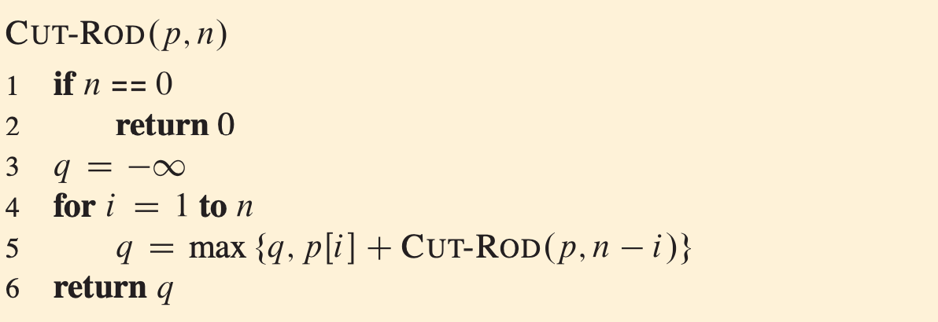
Solving Rod cutting problem

Slide 12
Solving Rod cutting problem
If you were to code up CUT-ROD in your favorite programming language and run it on your computer, you would find that once the input size becomes moderately large, your program would take a long time to run.

Slide 13
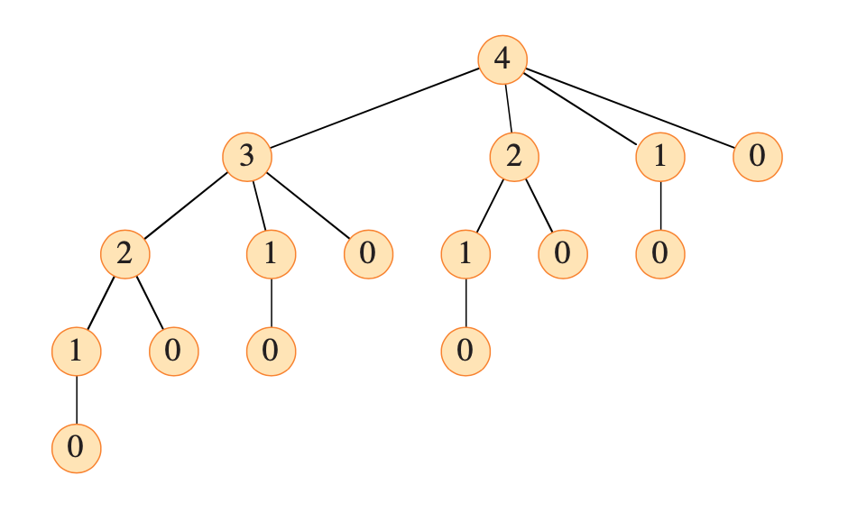
Solving Rod cutting problem

Slide 14
Solving Rod cutting problem
Top-down with memorization:
Write the procedure recursively in a natural manner
Save the result of each subproblem (usually in an array or hash table).
Checks to see whether it has previously solved this subproblem.
If so, it returns the saved value.
If not, the procedure computes the value in the usual manner but also saves it.

Slide 15
Solving Rod cutting problem
Bottom-up method:
Solving any particular subproblem depends only on solving “smaller” subproblems.
Solve the subproblems in size order, smallest first, storing the solution to each subproblem when it is first solved.
In this way, when solving a particular subproblem, there are already saved solutions for all of the smaller subproblems its solution depends upon.

Slide 16
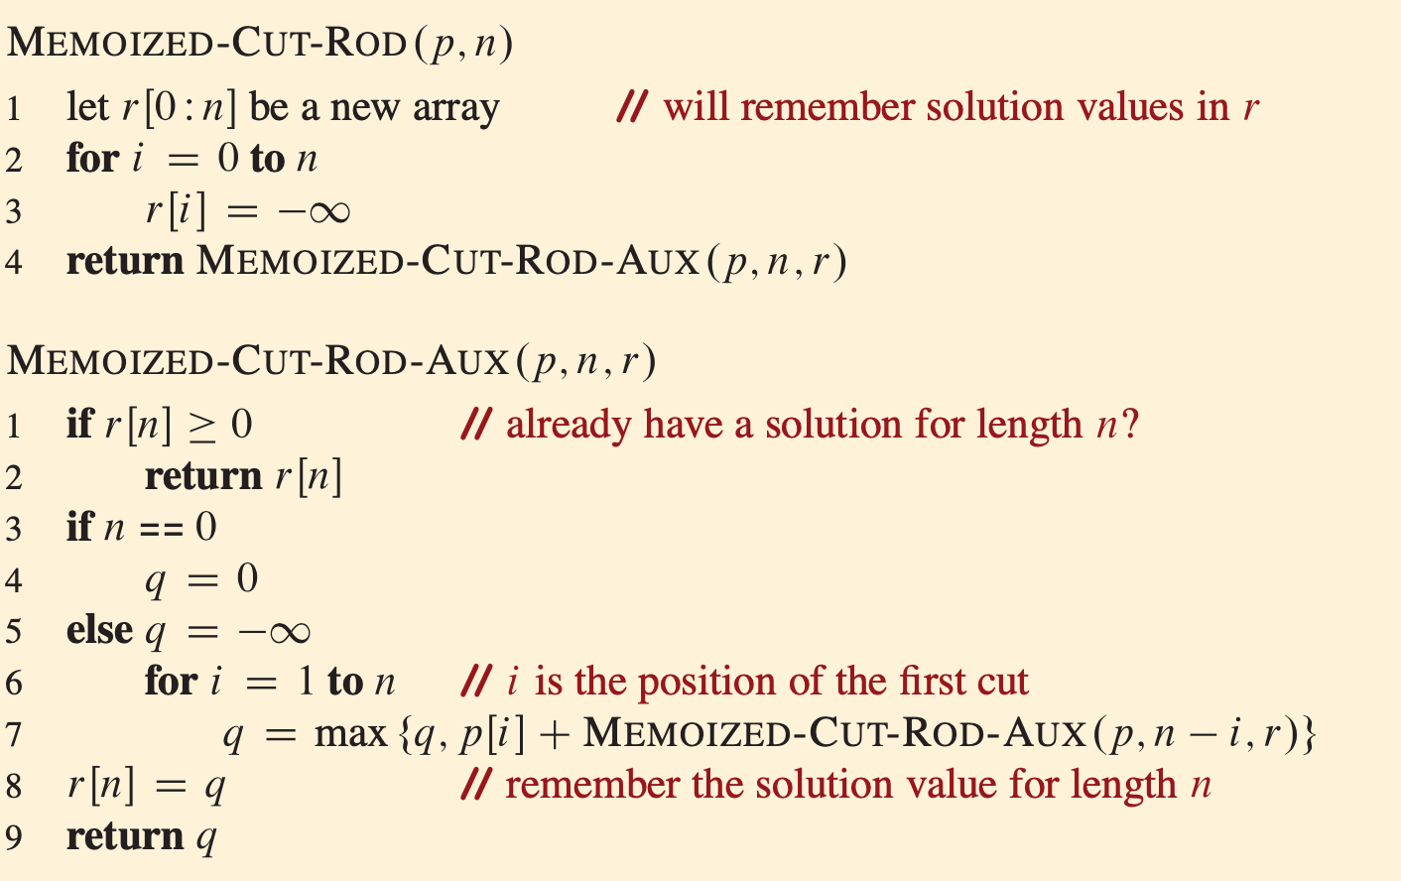
Solving Rod cutting problem

Slide 17
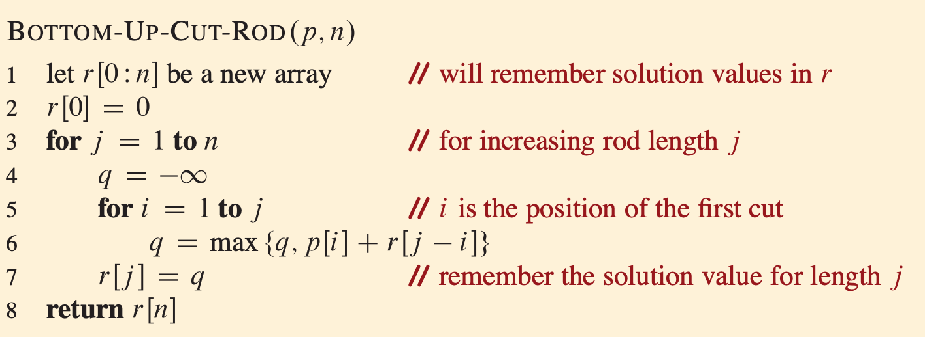
Solving Rod cutting problem

Slide 18

Solving Rod cutting problem
Both the approaches run at $Θ(n^{2})$ time.
Why?
Notes:
The top-down memoized running time may be a little harder to see. Because a recursive call to solve a previously solved subproblem returns immediately, MEMOIZED-CUT-ROD solves each subproblem just once. It solves subproblems for sizes 0, 1, …, n. To solve a subproblem of size n, the for loop of lines 6-7 iterates n times. Thus, the total number of iterations of this for loop, over all re- cursive calls of MEMOIZED-CUT-ROD, forms an arithmetic series, giving a total of iterations, just like the inner for loop of BOTTOM-UP-CUT-ROD. (We actually are using a form of aggregate analysis here.)

Slide 19
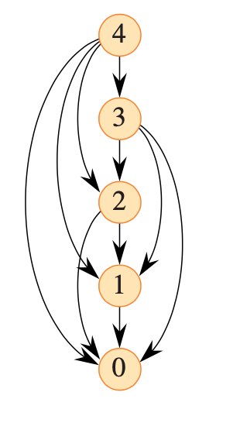
Solving Rod cutting problem
The subproblem graph for the problem embodies exactly the set of subproblems involved and how subproblems depend on one another.
Here we have The subproblem graph for the rod-cutting problem with n = 4.
The vertex label gives the sizes of the corresponding subproblems.
A directed edge (x, y) indicates that solving subproblem x requires a solution to subproblem y.
This graph is a reduced version of the recursion tree of in slide 12, in which all nodes with the same label are collapsed into a single vertex and all edges go from parent to child.

Slide 20
Solving Rod cutting problem
The procedures MEMOIZED-CUT-ROD and BOTTOM-UP-CUT-ROD return the value of an optimal solution to the rod-cutting problem, but they do not return the solution itself : a list of piece sizes.
Let’s see how to extend the dynamic-programming approach to record not only the optimal value computed for each subproblem, but also a choice that led to the optimal value.

Slide 21
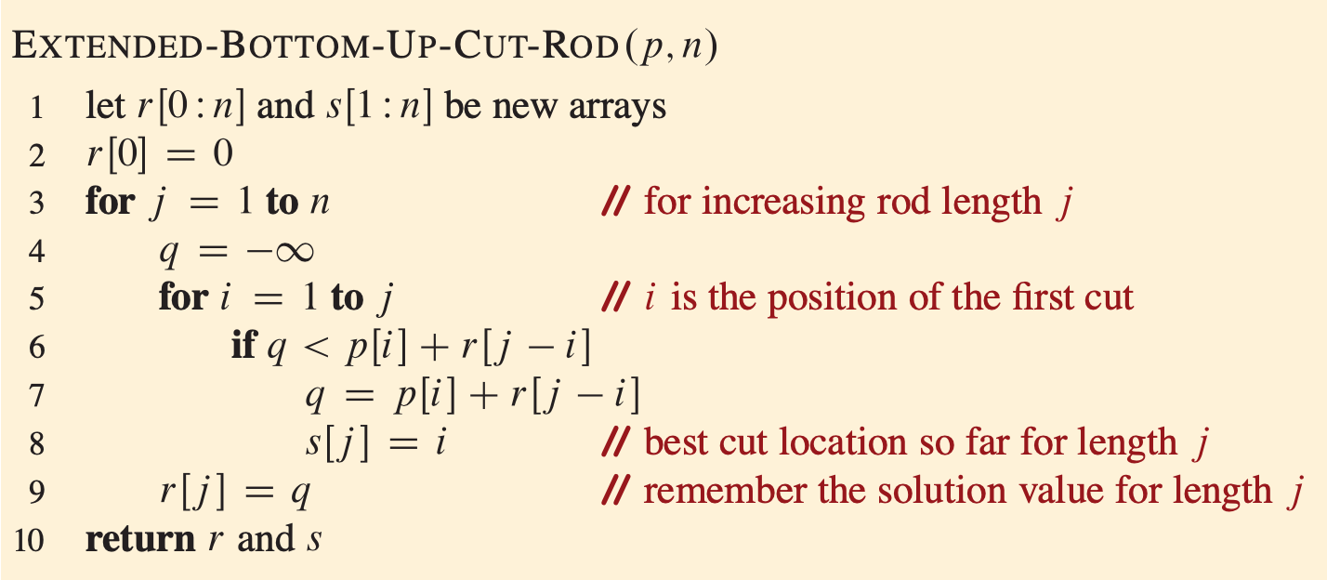
Solving Rod cutting problem

Slide 22
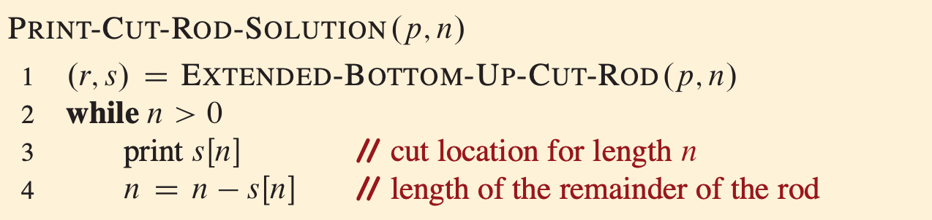
Solving Rod cutting problem
i | 0 1 2 3 4 5 6 7 8 9 10
r[i] | 0 1 5 8 10 13 17 18 22 25 30
s[i] | 0 1 2 3 2 2 6 1 2 3 10

Slide 23
Exercises
15
Consider a modification of the rod-cutting problem in which, in addition to a price pi for each rod, each cut incurs a fixed cost of c. The revenue associated with a solution is now the sum of the prices of the pieces minus the costs of making the cuts. Give a dynamic-programming algorithm to solve this modified problem.
Modify MEMOIZED-CUT-ROD to return not only the value but the actual solution.
The Fibonacci numbers are defined in session 04. Give an O(n)-time dynamic-programming algorithm to compute the n-th Fibonacci number. Draw the subproblem graph. How many vertices and edges does the graph contain?

Slide 24
References
Thomas H. Cormen. (2022). Introduction to algorithms: Fourth edition. The MIT Press. Chapter 14.
https://web.stanford.edu/class/archive/cs/cs161/cs161.1168/lecture12.pdf

Slide 25
Thank you
Dynamic programming: Rod cutting
September, 2023

